Slide 1
Langchain
Basics

Slide 2
What is Langchain
An open-source framework to build LLM applications.
Python and Typescript packages
Key values:
Modular Componentes : Composable tools and integrations for working with language models. Components are modular and easy-to-use, whether you are using the rest of the Langchain framework or not.
Ready for many common use cases.
Flexibility to create customized components.
https://www.langchain.com/

Slide 3
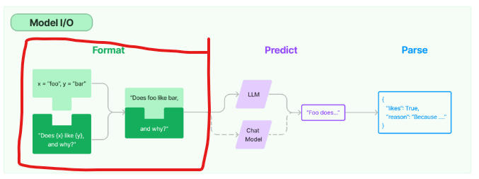
Langchain Components - Prompts
Prompt Templates : Uses a template with best prompt engineering practices to parametrized model inputs.
Templates will work for most models in the market, making them reusable.
Support use of variables in the prompt, if needed.
Types of off-the-shelf templates :
PromptTemplate : To create a template for a string prompt (default: Python str.format).
ChatPromptTemplate : To create a template for list of chat messages (role + content)
Custom prompt template : Customize at will with OOP .
https://python.langchain.com/docs/modules/model_io/prompts/prompt_templates/custom_prompt_template

Slide 4
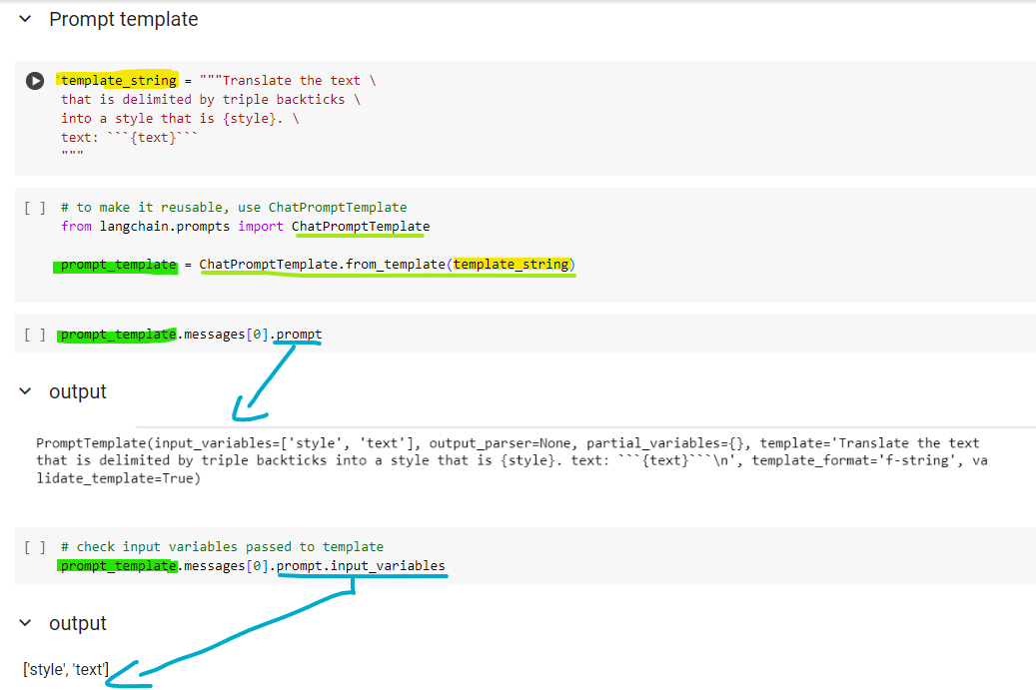
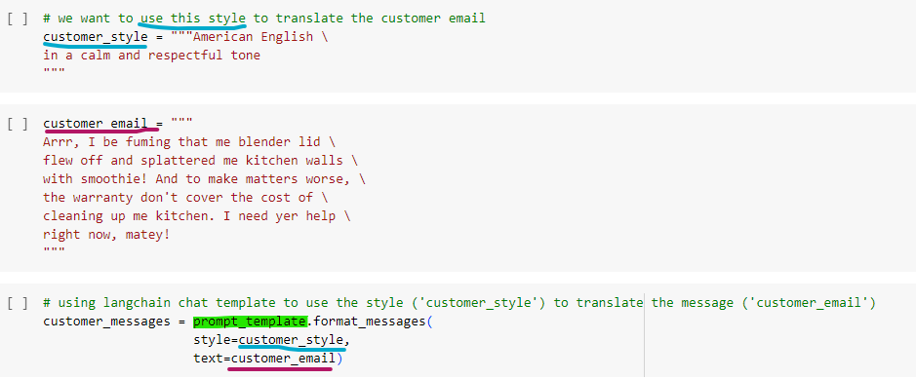
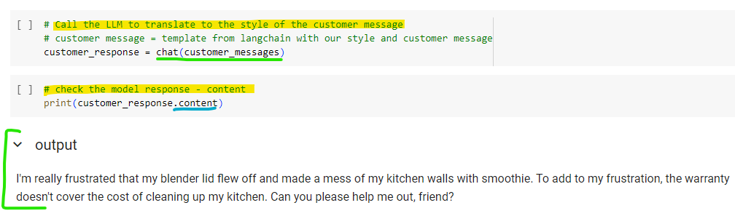

Slide 5
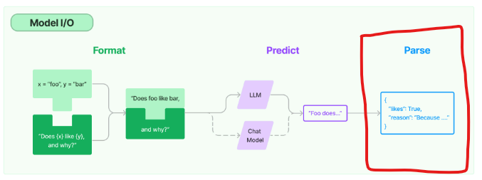
Langchain Components - Prompts
Output Parsers : Parse the model output (response) into the desired structured object to work with the data pipeline downstream.
Types :
List, Datetime , Enum , DataFrame , JSON, XML , etc.]
https://python.langchain.com/docs/modules/model_io/output_parsers/
Model outputs responses are strings, so it needs conversion for other uses - output parsers take care of this too

Slide 6
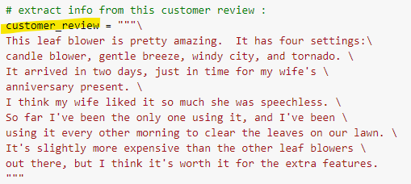
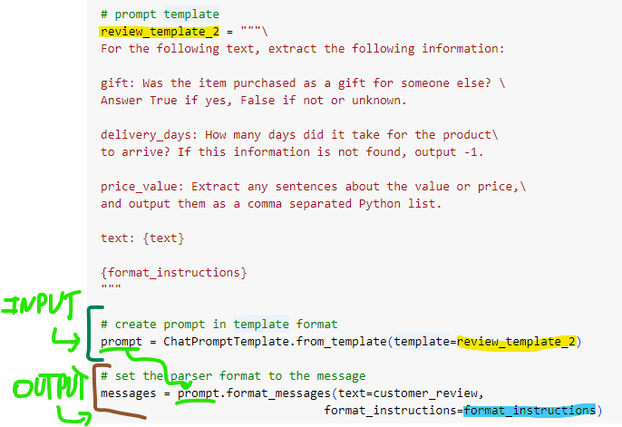
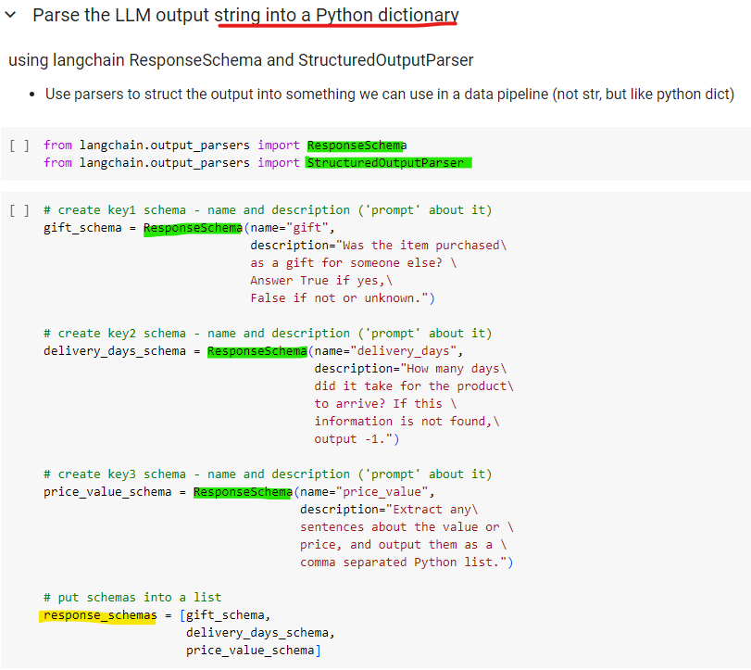
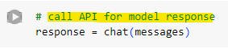
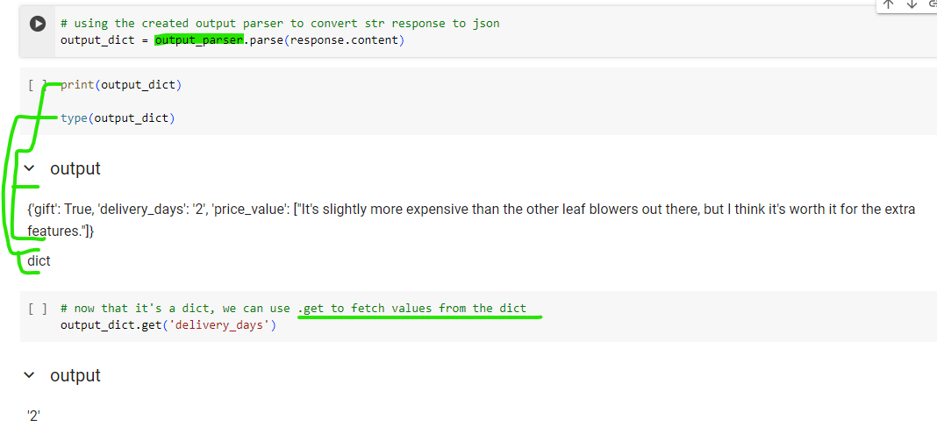
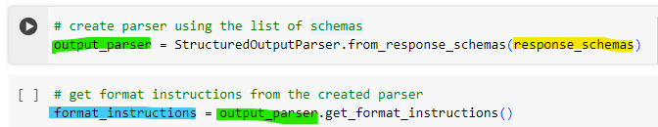

Slide 7
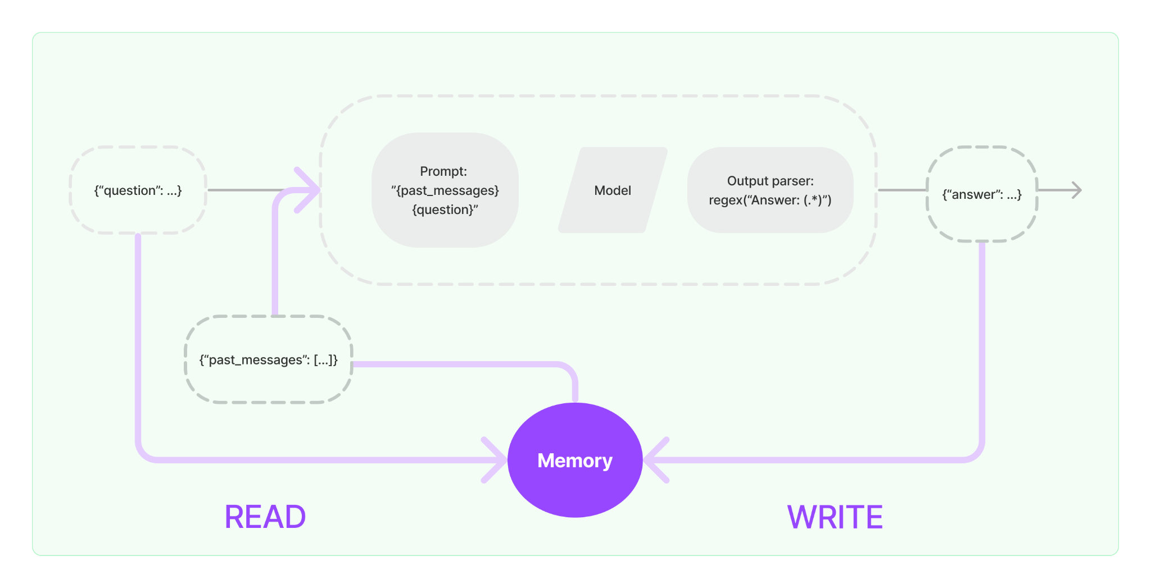
Langchain Components - Chat Model
Memory : Solves the limitation of LLMs being stateless (they dont store previous interactions), then it can be used as a chatbot.
Set parameter verbose = True if needs to follow the complete Conversation Chain.
Usually for debugging!
Memory Types :
> ConversationBufferMemory: Allows to store messages and then extracts it in a variable. Stores the whole conversation.
> ConversationWindowsBufferMemory: Stores only a predefined window. If parameter K = 3 , will store the last 3 interactions only. This is one strategy to avoid hitting the memory limit of your system.
> ConversationTokenBufferMemory : Stores only a predefined token quantity (param max_token_limit). This is a good strategy to deal with pricing of the API calls (it is per token)
> ConversationSummaryMemory : Stores the summary of the interaction to the conversation. Can be limited by max tokens for the summary to be generated. Good strategy when input is a long string (emails, product reviews, etc) so we can store only the relevant points from the summary instead of the long string itself.
> ConversationEntityMemory : Stores facts about entities in a conversation. Uses an LLM for that..
> VectorStoreRetrieverMemory : Stores memories in a vector store and queries the top-K most
important docs every time it is called.
> ConversationKGMemory : Uses knowledge graph to recreate memory.
Different memories can be used together in a system!
https://python.langchain.com/docs/modules/memory/

Slide 8
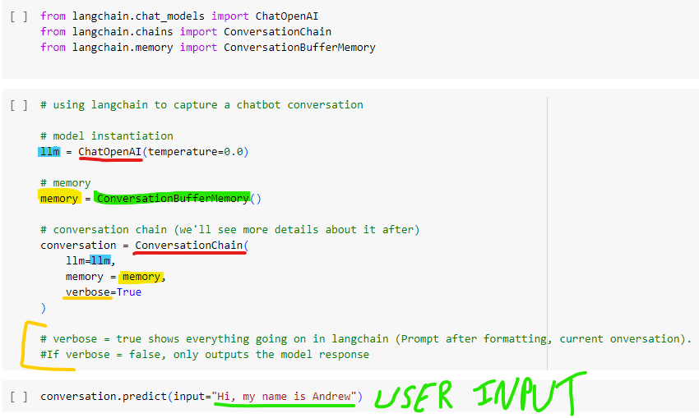
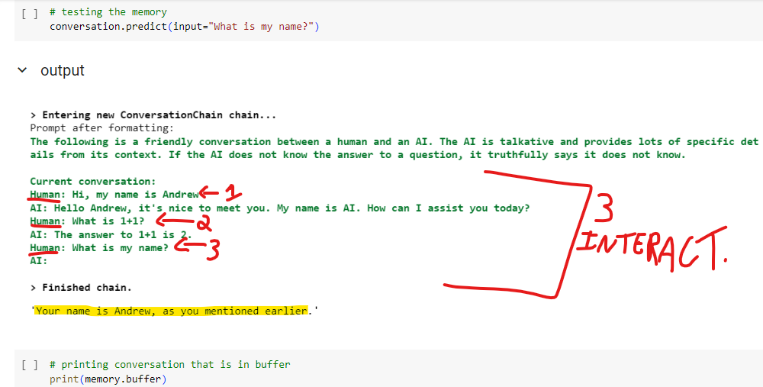
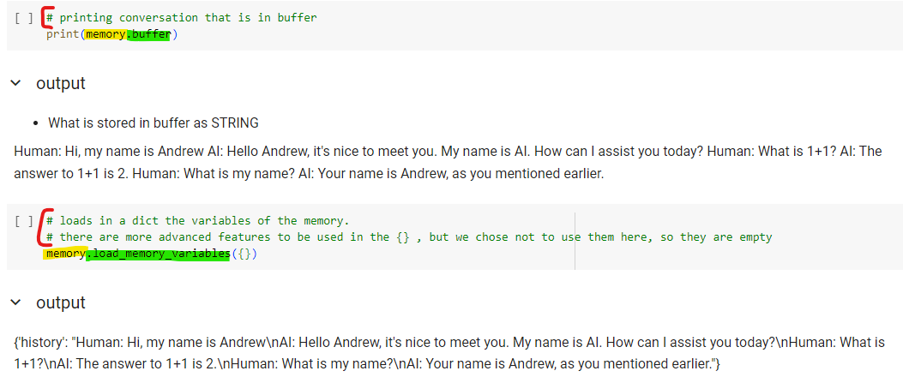
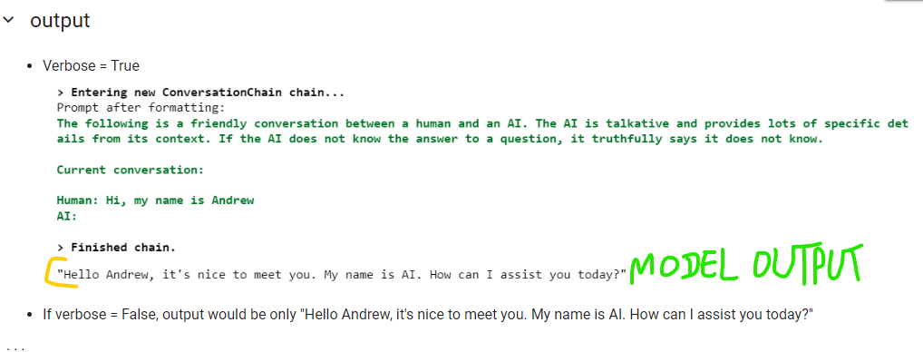
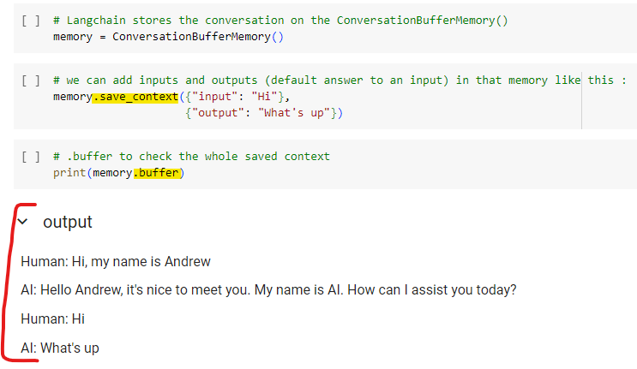

Slide 9
Langchain Components - Indexes
These components allow Langchain to work with large documents, like PDFs, Notions, etc. Before that, an overview of some concepts :
Q&A over a Document - Process where the LLM gets a Question about the data in the document, queries the data looking for the piece that will then Answer the user’s input.
RAG - Retrieval Augmented Generation. The LLM retrieves contextual documents from an external source (PDF, video, database, API, etc.). It is one approach to specialize a model in the desired data domain.
Tokenization - Process where text is broken down into smaller pieces (tokens).
Document - Chunks of a larger text corpus or files, such as PDFs. In Langchain, when large files are split, each resulting chunk is called a 'document' for processing.
Document Splitting - The division of large files into smaller parts, each of which is then referred to as a "document" for the purposes of indexing and processing within Langchain.
Embedding - Transformation of tokens or entire documents into numerical representations, (vectors). This process enables the language model to understand and compare the meaning of texts by analyzing their vector representations. Text with similar content/meaning will have similar vectors.
Vector Store - A database that stores numerical vectors representing text data for fast retrieval based on similarity score calculation. The most similar documents are retrieved from it, then the LLM elaborates the response based on them. Also, can creates an index to identify the loaded documents for fast retrieval (becoming then a vector database).

Slide 10
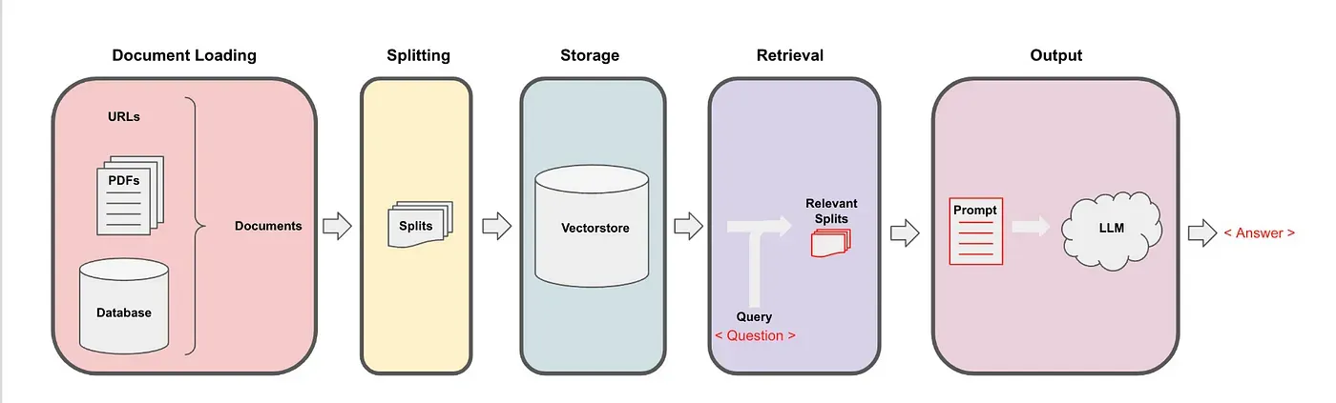
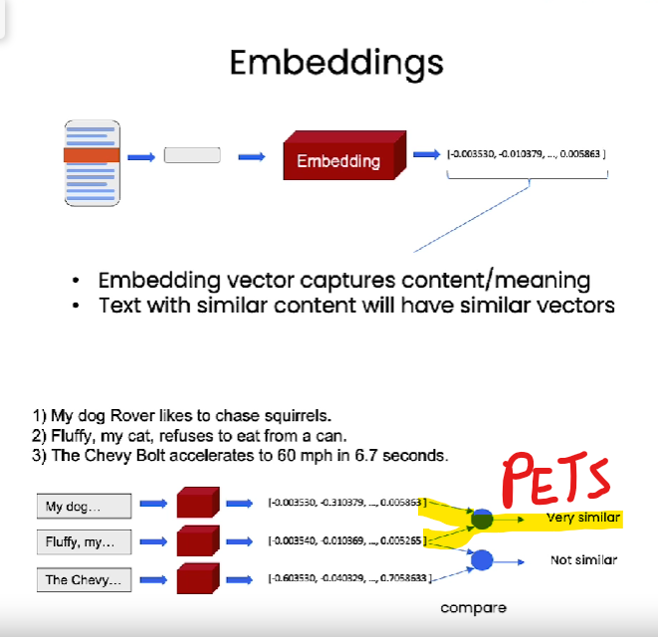
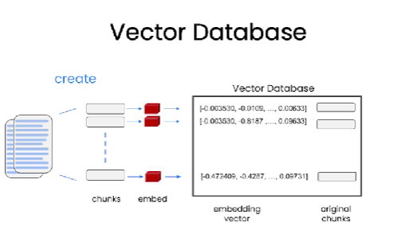
Langchain Components - Indexes
Q&A over a document with RAG (vector store)
Embedding

Slide 11
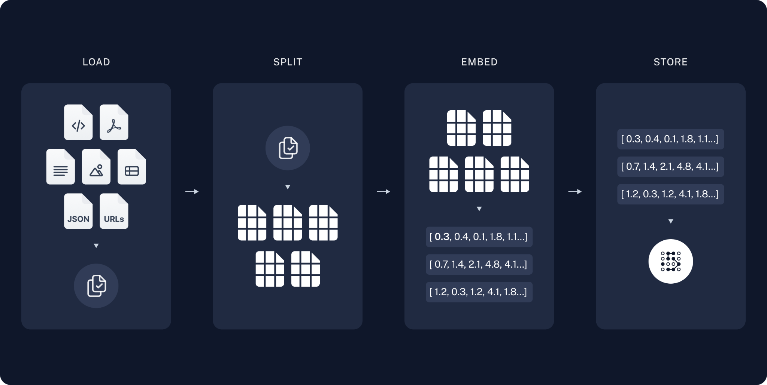
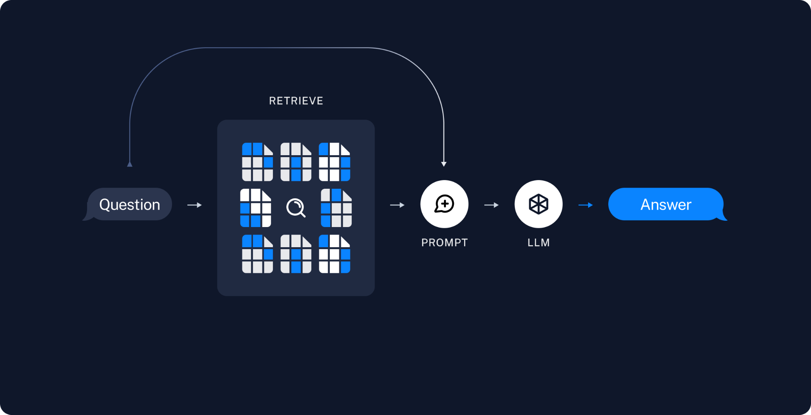
Langchain Components - Indexes
The summary of the RAG process with vector store is :
1- Input user’s query into system
2 - Create embedding for the query
- Break the query into smaller chunks (documents) with index .
3 - Compare the indexed chunks (entries, from user query) with the ones in the vector database
Using similarity score
4 - Pick from the vector database the "N" chunks most similar to the entries
5 - The selected chunks are returned and then passed to the model, in a prompt
6 - The model generates the final answer (response) to the user based on those similar chunks from the vector database.

Slide 12
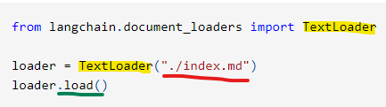
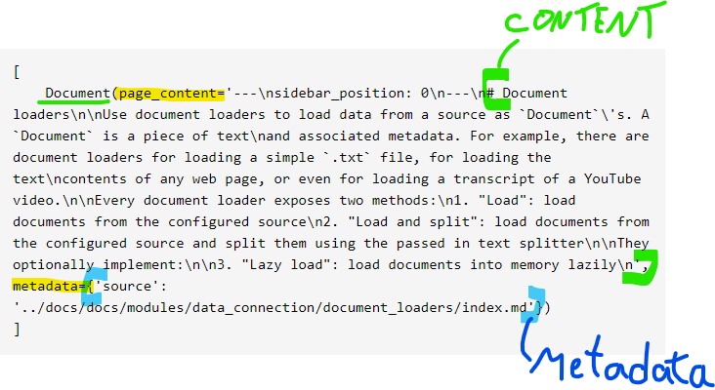
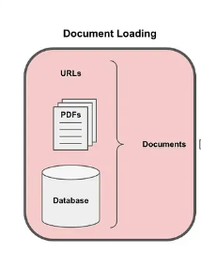
Langchain Components - Indexes
Document Loaders : Used to load data from a source as Documents (chunk of text + associated metadata). Pre-defined Document Splitting strategy for each type.
The simplest loader reads in a file as text and places it all into one document.
They optionally implement a "lazy load" as well for lazily loading data into memory.
Information is only loaded into memory when it is needed, rather than at the start.
Improves performance and reduce memory usage when working with large documents.
Data Loaders types :
CSV - Each row is a document
File Directory
HTML - each page is a document
JSON - define document by jq_schema
Markdown
PDF - each page is a document
Unstructured - Load files of many types. Allows to
pass in a strategy param to define how to split the document.
Many other available : https://python.langchain.com/docs/integrations/document_loaders

Slide 13
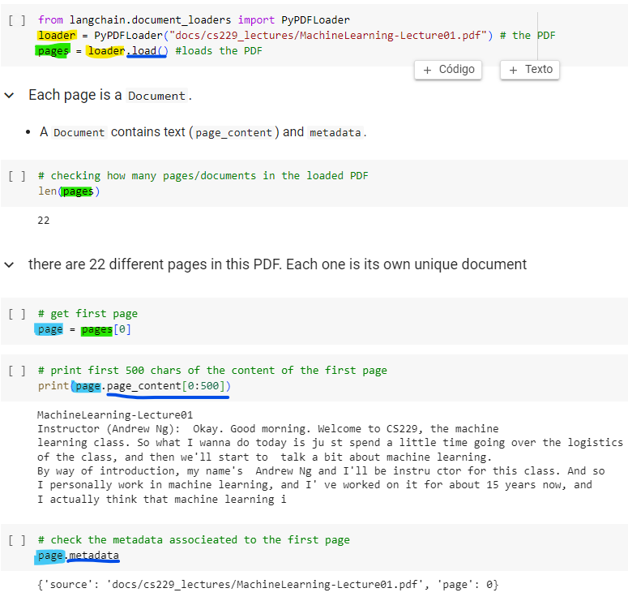
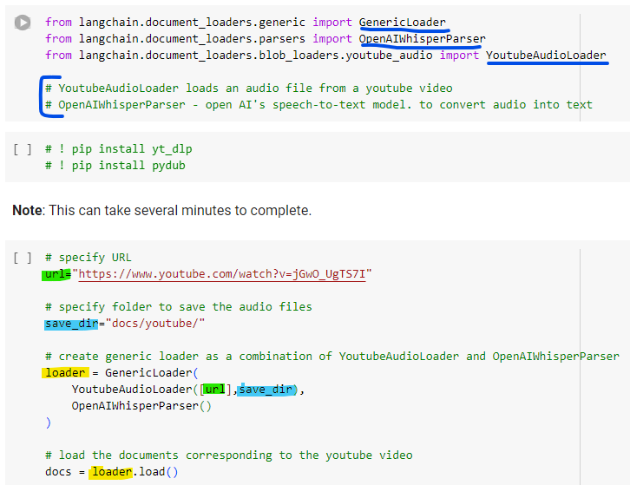
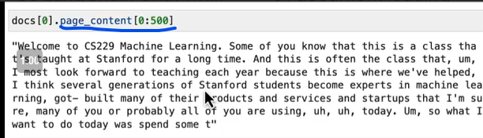
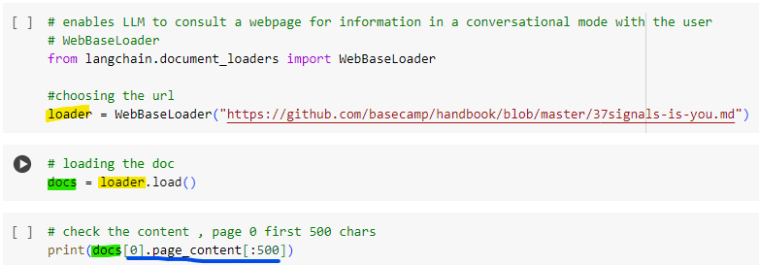
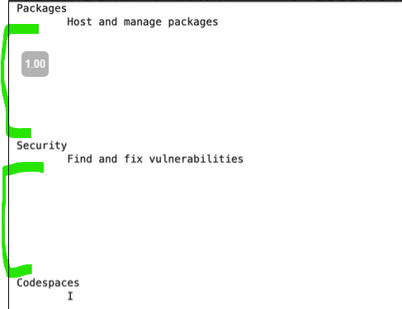
Outputs a lot of whitespaces. This is a good example why we should do some post processing before taking the data into vector store and LLM.

Slide 14
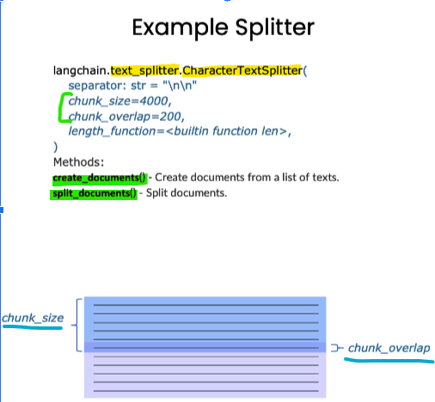
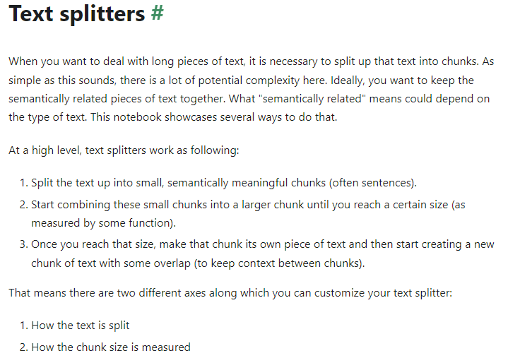
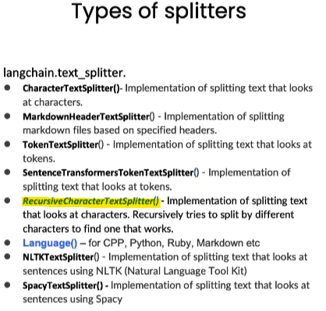
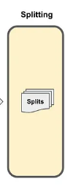
Langchain Components - Indexes
Document Splitters: The next step after loading the data as a document. The objective is to split into smaller chunks, but preserving semantically cohesive content.
Inaccurate splitting can fracture sentences, impeding later retrieval.
Lang Chain subdivides texts based on criteria like chunk size and overlap.
Chunk size can vary based on characters or token numbers
Overlap maintains consistency in segments
Lang Chain provides functionality for document creation and division.
Metadata continuity is crucial during the division

Slide 15
Langchain Components - Indexes
Document Splitters - Types of Splitters
Character-based Splitters: Splits documents based on character count.
Token-based Splitters: Splits using token counts or model-driven sentence termination.
Code-specific Splitters: Tailored for coding documents with language-specific separators.
Doc : https://python.langchain.com/docs/modules/data_connection/document_transformers/
Document Splitters - Metadata Handling
During splitting, metadata from the source document is carried over to the segments.
Enriching chunks with added metadata can be advantageous. (Tracking).

Slide 16
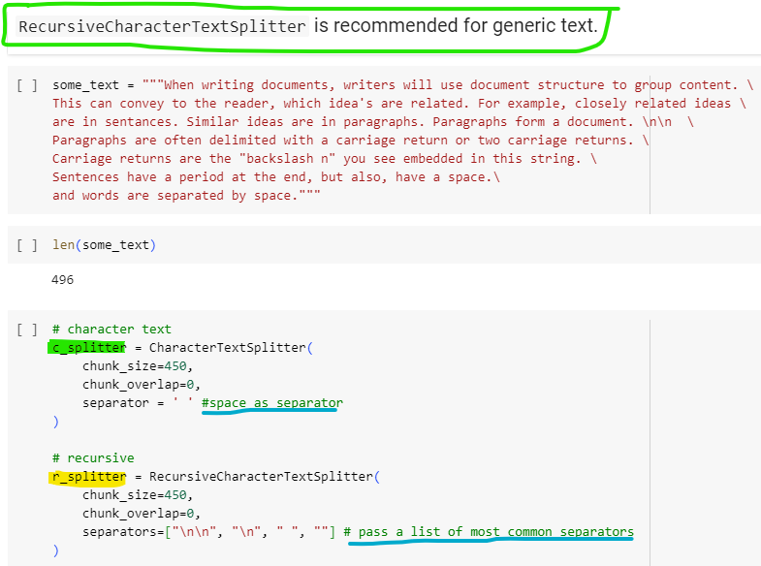
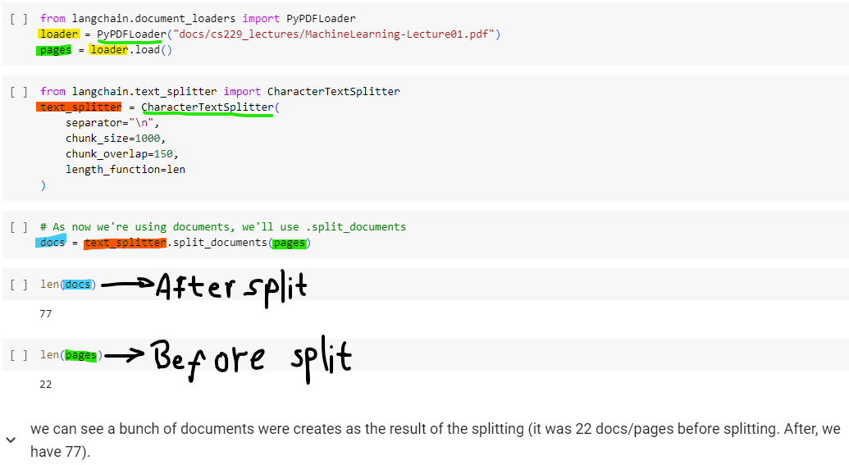
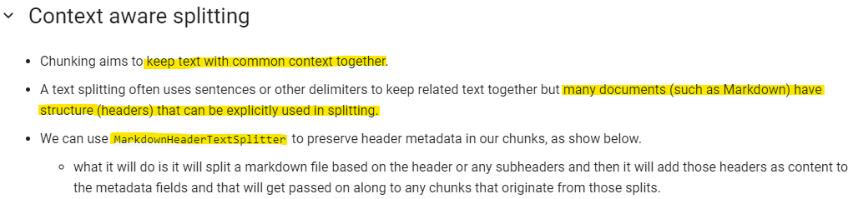
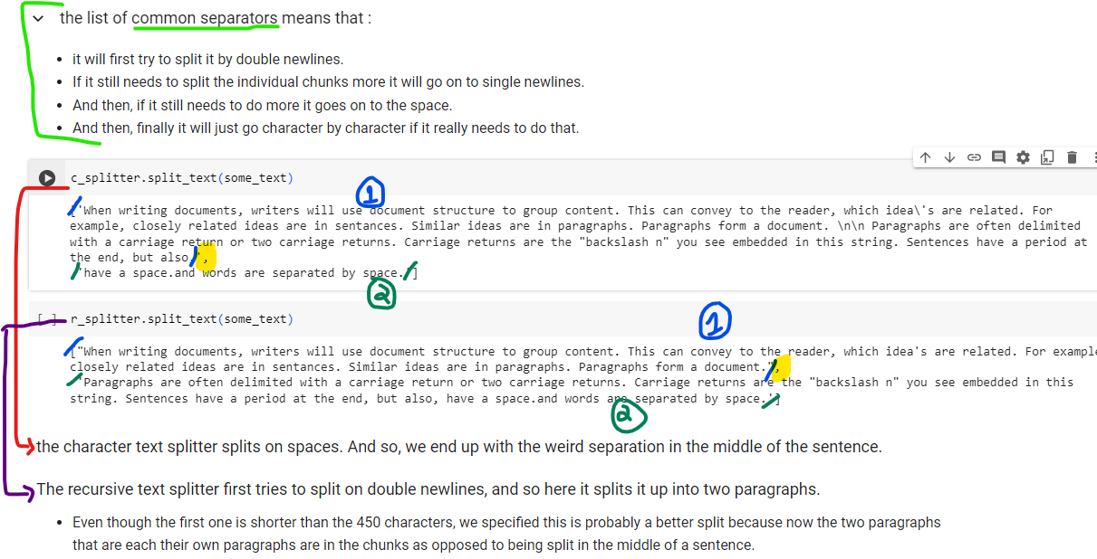
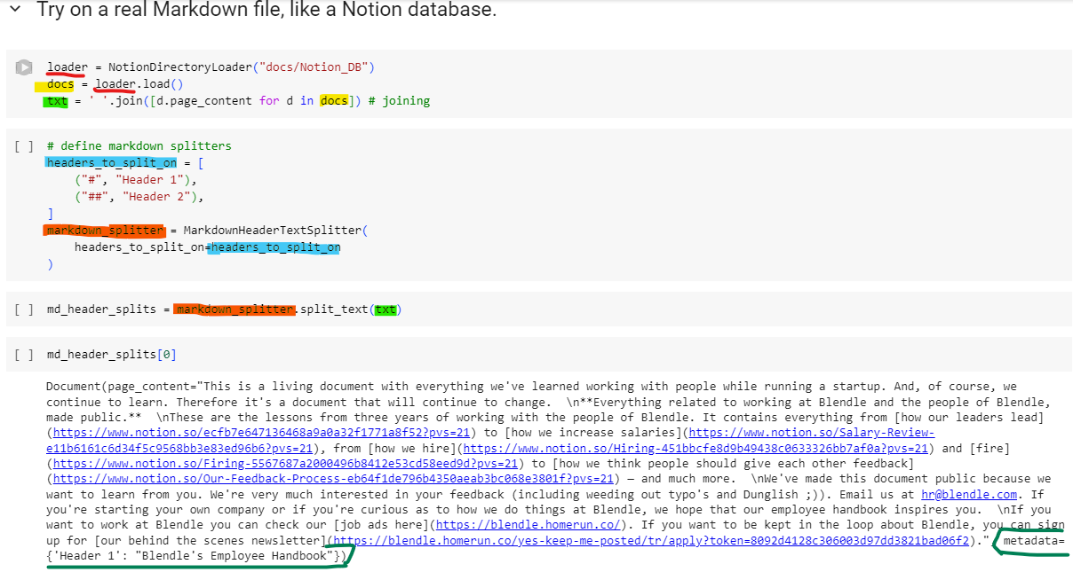

Slide 17
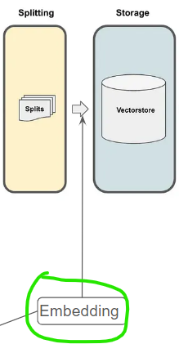
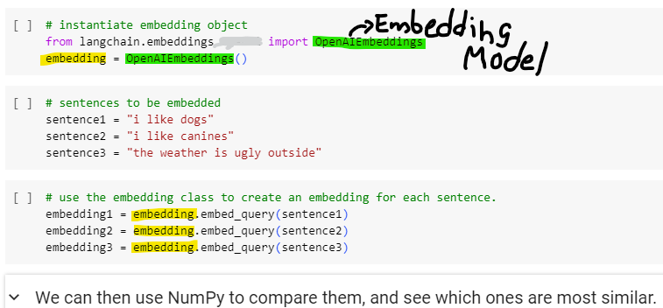
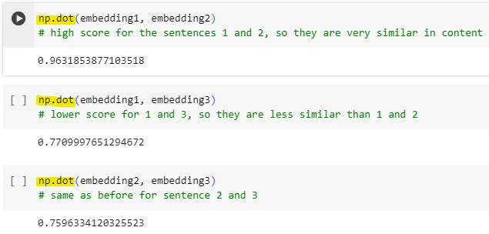
Langchain Components - Indexes
Embedding : The next step after splitting the documents. The objective is to embed each document - convert text into a vector (numerical representation).
Text with similar content will have similar vectors in the vector space, enabling comparison.
Using dot product between the vectors (A higher value indicates more similarity between the sentences).
The dot product is a measure of how much two vectors align in the vectorial space.
Langchain supports many Embeddings models : https://python.langchain.com/docs/integrations/text_embedding

Slide 18
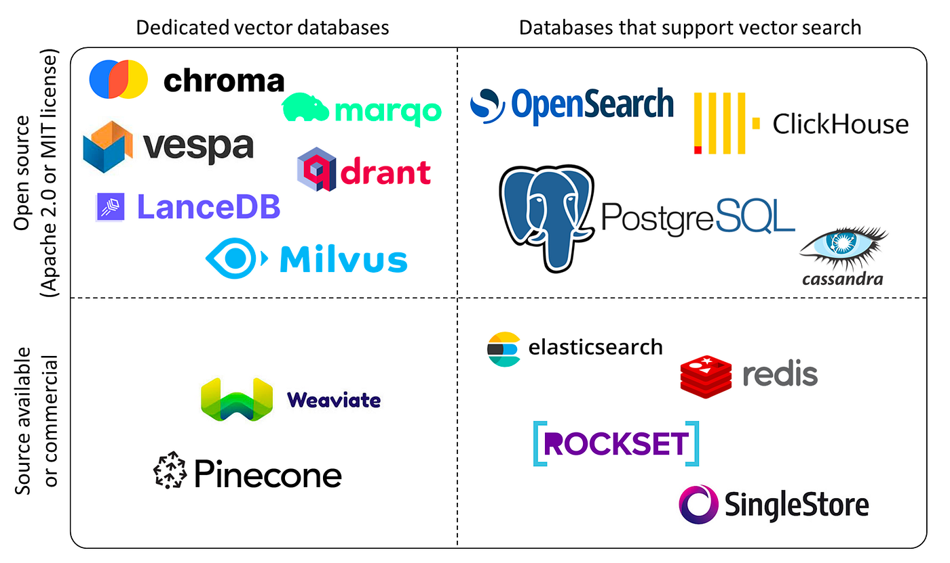
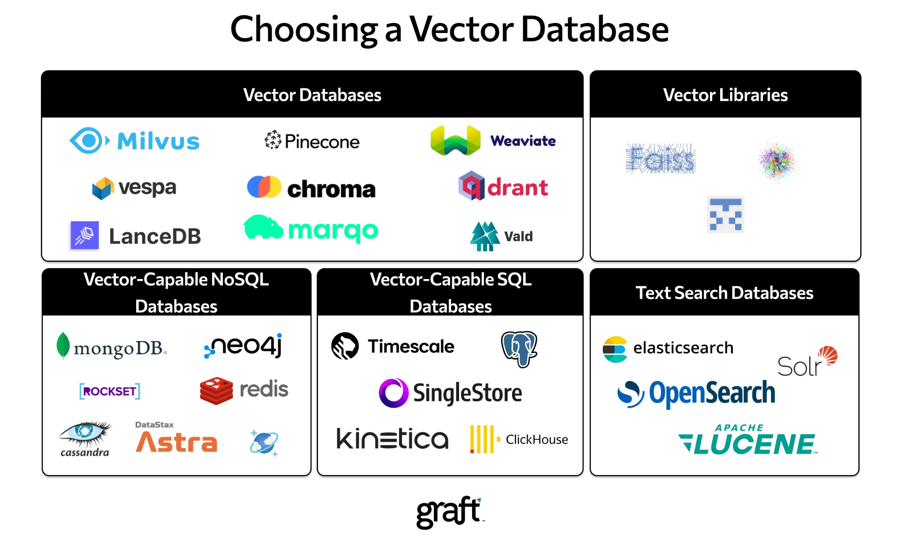
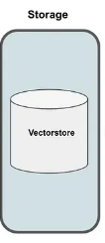
Langchain Components - Indexes
https://python.langchain.com/docs/integrations/vectorstores
https://python.langchain.com/docs/modules/data_connection/indexing
Vector Store : Stores the vectors (embedded documents) to retrieve the similar ones during Retrieval phase.
Store the question's embedding, compare it with vectors in the vector store, and retrieve the most ‘k’ similar entries.
Vector databases are a particular implementation of a vector store where each vector is also identified by a key (index). This can allow, for instance, the text generated by RAG to also include a citation for the document from which it was received. Also, allows fast retrieval.
A vector database indexes the vector embeddings. This step maps the vectors to a data structure that will enable faster searching. Supports full CRUD.

Slide 19
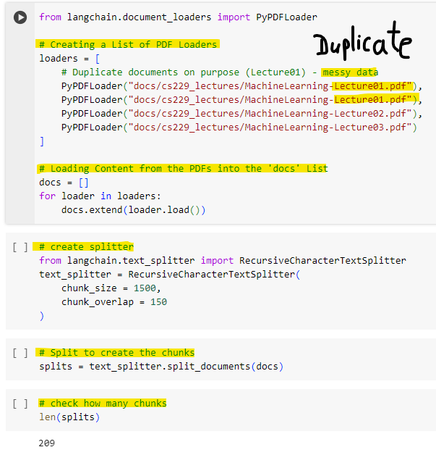
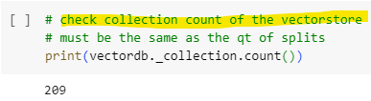
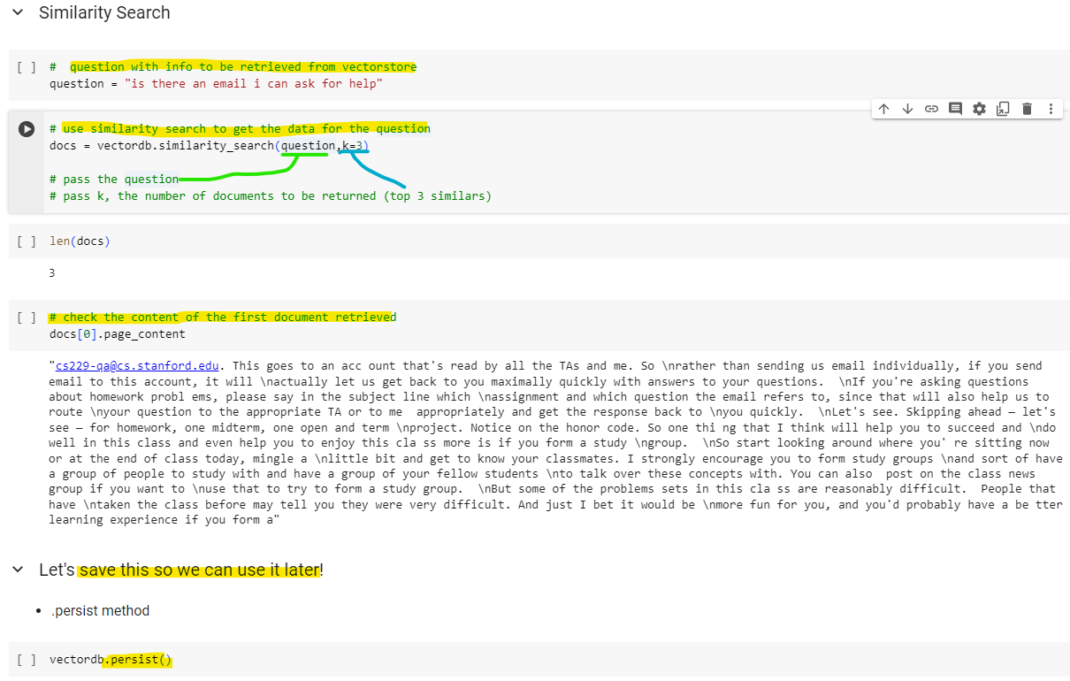
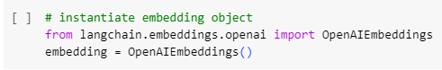
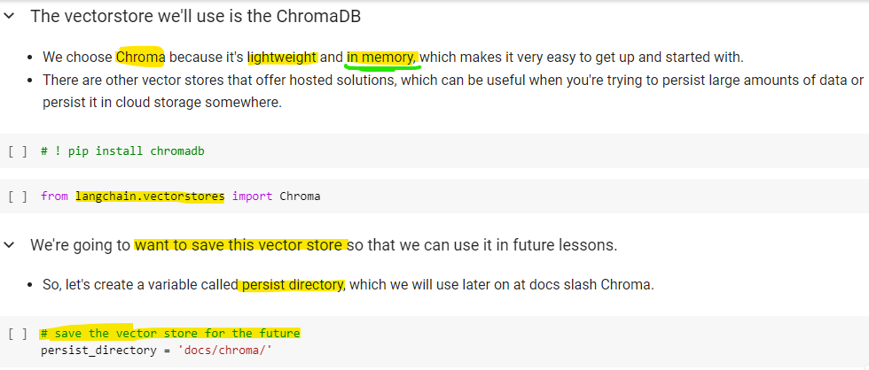

It means that the information retrieved (the top 3 similar documents) is being saved in the database. This impacts the system by ensuring that the data does not need to be recalculated in future searches; instead, it can be quickly retrieved from the database, thereby saving time and computational resources.

Slide 20

Langchain Components - Indexes
Retrievers: Used to retrieve the top ‘k’ most similar documents from the vector store, based on the chosen similarity measure strategy.
Similarity Measure Strategies
Similarity/Semantic Search : Basic strategy, solves for 80% of cases, but is limited due to not enforcing diversity.
If there are duplicate documents, it will fetch all duplicates in top k most similars, not adding any new information.
MMR : Maximum Marginal Relevance. Ensure diversity in the results by choosing the most ‘k’ diverses from the top ‘fetch_k’ similars.
Problem : Solely relying on document similarity might miss diverse information.
Self-query : Useful when you get questions that aren't solely about the content, but also include some information about metadata that you want to do a filter on. We can use a model itself to split that original question into two separate things,a filter and a search term. Ex : “What are some movies about aliens made in 1980?”
We often want to infer the metadata from the query itself.
Contextual Compression : Integrates MMR and semantic search for concise, non-redundant results, by using a model to extract essential parts from the top ‘k’ most similars. Tradeoff : requires more model calls, increasing computational overhead and cost.
https://python.langchain.com/docs/modules/data_connection/retrievers/
https://python.langchain.com/docs/integrations/retrievers

Slide 21





Without the manual filter, sim.search would fetch ‘regression’ documents from other lessons as well.

Slide 22






The code sets up a SelfQueryRetriever to efficiently locate information within a document store by using a language model to process queries together with metadata info, extracted from the query itself.
Metadata attributes are defined to guide the search process, and the language model is initialized.
The SelfQueryRetriever is configured to interpret queries and apply metadata filters, allowing for precise retrieval of documents based on metadata fetched from the query (not hardcoded as the filter used at similarity search).
In the end, the metadata from the fetched docs are printed to show they belong to the third lesson as requested.

Slide 23



Information most relevant to a query may be buried in a document with a lot of irrelevant text.
Passing that full document through your application can lead to more expensive LLM calls and poorer responses.
Contextual compression is meant to fix this.
It is possible to use multiple retrievers together. For more information, check
https://python.langchain.com/docs/modules/data_connection/retrievers/ensemble

Slide 24
Workflow:
1 - Start with documents.
2 - Split them into smaller segments.
3 - Create embeddings for these segments.
4 - Store the embeddings in a vector store.
5 - Retrieve relevant documents from store to answer user’s question.
*** The user’s question should be previously embedded, to compare with the vectors in the store.

Slide 25
Langchain Components - Chains/LCEL
Chains : Combines LLM Model + prompt (+ components if needed) into a building block. One of the most important features in Langchain.
The building blocks can be used together to create a sequence of operations.
‘Chain’ is legacy approach, now it is ‘LCEL’ - LangChain Expression Language
A declarative way to easily compose chains together. Designed to support putting prototypes in production, with no code changes, from the simplest “prompt + LLM” chain to the most complex chains.
LCEL Supports Streaming , Async , Optimized parallel execution , Retries and fallbacks , Access intermediate results , Input and output schemas , Seamless LangSmith tracing integration , Seamless LangServe deployment integration .
https://python.langchain.com/docs/expression_language/
https://python.langchain.com/docs/modules/chains/

Slide 26



Chain Creation: The prompt, model, and StrOutputParser() are chained together using the | operator, creating a runnable pipeline. StrOutputParser() is used to convert the model's responses into a string format.
Streaming Data: The runnable.stream() function is then called with a historical question about Mansa Musa. This function creates a stream of data, which allows for processing large amounts of data or handling real-time data efficiently.
The use of streaming in this context (as opposed to processing a single, large batch of data) suggests that the system is designed to handle continuous input and output. This can be particularly useful in a chat setting where questions are asked and answered sequentially, and the conversation flow must be maintained without waiting for a large number of responses to be generated at once.
The final loop prints each chunk of the response as soon as it's generated, ensuring that the output is provided to the user in real-time, which enhances the interactive experience.
The flush=True parameter in the print function ensures that the output buffer is flushed immediately, which is important for streaming data to the console without delay.
Output :
"Why did the ice cream go to therapy?\n\nBecause it had too many toppings and couldn't find its cone-fidence!"

Slide 27
Langchain Components - Chains/LCEL
https://python.langchain.com/docs/modules/chains/foundational/
Chains - Foundational :
LLM : The most common type of chaining in any LLM application is combining a prompt template with an LLM and optionally an output parser.
BasePromptTemplate, BaseLanguageModel and BaseOutputParser all implement the Runnable interface (pipe operator) and are designed to be piped into one another, making LCEL composition very easy.
Router : Allows to create non-deterministic chains (where the output of a previous step defines the next step).
Sequential : Useful when you want to take the output from one call and use it as the input to another.
Transformation : Allow to transform inputs as they are passed from one component to another, like a summarization or extraction.

Slide 28



Transformation
Takes in a super long text, filters the text to only the first 3 paragraphs, and then passes that into a chain to summarize those.
Sequential
A chain that first creates a play synopsis and then generates a play review based on the synopsis.
Router example : https://python.langchain.com/docs/modules/chains/foundational/router

Slide 29

Langchain Components - Chains/LCEL
https://python.langchain.com/docs/modules/chains/document/
Chains - Documents : The core chains for working with documents. They are useful for summarizing documents, answering questions over documents, extracting information from documents, and more.
These chains all implement a common interface:

Slide 30
Langchain Components - Chains/LCEL
https://python.langchain.com/docs/modules/chains/document/
Chains - Documents Types :
Stuff : Incorporates all documents into the final prompt given to the language model. suited for applications where documents are small and only a few are passed in for most calls.
Pros: Efficiency: Only requires a single call to the language model.
Cons: Capacity Limitation - If there's an excess of documents, they might not fit within the model's context window.
Refine : Sequentially combines the previous response with new data, then asks the model for an improved response. Constructs a response by looping over the input documents and iteratively updating its answer. For each document, it passes all non-document inputs, the current document, and the latest intermediate answer to an LLM chain to get a new answer. suited for tasks that require analyzing more documents than can fit in the model’s context
Pros: Can get more relevant context than stuff.
Cons: Makes more calls to the model then stuff method that are not independent (can’t be done in parallel), not the best choice when documents frequently cross-reference one another or requires detailed information from many documents.
Map reduce : Each document is separately given to the language model to get an initial answer (Map). Then, these answers are combined into a final response with another call to the language model (Reduce).
Pros: Scalability - Can process an indefinite number of documents. Calls to the model are independent (can be parallelized).
Cons:
Speed: It's considerably slower due to multiple calls to the language model.
Inaccuracy: The results might be less accurate, especially if information is distributed across multiple documents. The model processes each document separately, so it might miss the broader context if data is dispersed.
Requires many more calls than stuff.
Map re-rank : Runs an initial prompt on each document, that not only tries to complete a task but also gives a score for how certain it is in its answer. The highest scoring response is returned.
Pros: Similar to MapReduce + requires fewer calls.
Cons: Cannot combine informations among documents. So, best suited when expected a simple answer in a simple document.

Slide 31





Slide 32
Langchain Components - Chains/LCEL
https://python.langchain.com/docs/modules/chains/how_to/
Chains - How to :
Async API : LangChain provides async support by leveraging the asyncio library
Async API are used for many web applications, as it has a non-blocking behavior (one request won’t block the application until the response is served), enables concurrency (allow multiple tasks to be processed at the same time), scalability (handles with large number of operations and requests without using multithread).
Custom Chain : To implement your own custom chain you can subclass Chain and implement some methods (check doc).
Add Memory : Chains can be initialized with a Memory object, which will persist data across calls to the chain. This makes a Chain stateful.

Slide 33
Langchain Components - Agents
https://python.langchain.com/docs/modules/agents/
Agents : Use a language model to decide a series of actions. In chains, these actions are hardcoded in the code. But in agents, the language model figures out which actions to take and in what order. Key components:
Agent : The chain responsible for deciding what step to take next, powered by LLM + prompt. Different agents have specific prompting styles for reasoning, ways of encoding inputs, and ways of parsing the output. It is possible to create custom agents.
Inputs of the chain : tools (descriptions of available tools) , user input (the high level objective) , intermediate steps (any “(action, tool output)” pairs previously executed in order to achieve the user input)
Outputs of the chain : The next action(s) to take or final response to user (AgentActions or AgentFinish)
Tools : Functions that an agent can invoke. LangChain provides a wide set of built-in tools, but also makes it easy to define your own Two main design considerations:
Giving the agent access to the right tools
Describing the tools in a way that is most helpful to the agent
Toolkits : Groups of tools needed to accomplish specific objectives of common tasks. Ex : GitHub toolkit has a tool for searching through GitHub issues, a tool for reading a file, a tool for commenting, etc.
AgentExecutor : The runtime for an agent. Calls the agent, executes the actions it chooses, passes the action outputs back to the agent, and repeats, handle common errors, logging. You can also create custom execution logic.

Slide 34
Langchain Components - Agents
ReAct : Prompting strategy Framework that combines chain of thought reasoning + action planning. (Reasoning + Acting)
Uses structured examples to show a large language model how to reason through a problem and decide on actions to take that move it closer to a solution.
Thought-action-observation trio structure
In the ReAct framework, the LLM can only choose from a limited number of actions that are defined by a set of instructions that is prepended to the example prompt text. Else, hallucination.
Repeat the cycle until the final answer is obtained
The ReAct framework is built-in the Langchain Agents !

Slide 35


Langchain Components - Agents
PAL: Framework that enable LLMs to interact with external code interpreters (Program-Aided Language models).
For complex calculations, rather than have an LLM generate the answer directly, it’s better to have the LLM generate code to calculate the answer, and then run that code to get the answer.
Langchain provides a simple Python REPL to execute commands in.
https://realpython.com/python-repl/
The PAL framework is used to build Tools for Langchain Agents !

Slide 36






Slide 37
Langchain Components - Agents
Agent Types : Agents use an LLM to determine which actions to take and in what order. An action can either be using a tool and observing its output, or returning a response to the user. Here are the agents available in LangChain.
Zero-shot React : Uses ReAct to decide which tool(s) to use, based only on the description(s).
This is the most general purpose action agent.
Structured input ReAct : Capable of using multi-input tools. Can use a tools' argument schema to create a structured action input.
Useful for more complex tool usage, like precisely navigating around a browser.
OpenAI Functions : Designed for specific OpenAI models that are trained to identify when to call a function and what inputs to use for it.
Conversational : Designed to be used in conversational settings .
Uses ReAct framework to decide which tool to use, and uses memory to remember the previous conversation interactions. Prompt is designed to make agent helpful and conversational.
Self-ask with search : Uses a single tool 'Intermediate Answer’ , that looks up factual answers to questions.
ReAct document store : Uses ReAct to interact with a docstore.
Must provide a ‘Search’ tool (searches for a doc) and a ‘Lookup’ tool (look up a term in the found doc).

Slide 38



Agents + ReAct + PAL
Agents + ReAct

Slide 39
Key Takeaway
LangChain provides modular components for working with LLMs
Prompt templates and memory for storing interactions
Pre-built tools for working with datasets and APIs
Connecting a selection of the individual components together results in a chain.
Predefined chains optimized for different use cases
Sometimes your application workflow could take multiple paths depending on the information the user provides. In this case, you can't use a predetermined chain, but instead we'll need the flexibility to decide which actions to take as the user moves through the workflow (AGENTS).
Agents for PAL, ReAct, and other functionalities
You can use it to interpret the input from the user and determine which tool or tools to use to complete the task. LangChain currently includes agents for both PAL and ReAct, among others. Agents can be incorporated into chains to take an action or plan and execute a series of actions.

Slide 40

Langchain as Orchestrator of modularized functionalities of the LLM-powered system

Slide 41


